Slide 1
Hyperlinks for navigation
A short example of splitting up content
Click here to continue

Slide 2
Choose your plane
Click on one of the three options below to find out more about some common wood planes
The smoothing plane
The plough plane
The fillister plane
Each of these buttons is a text box with a shape fill and outline to stand out. Right click on an object, select Hyperlink from the options, then Place in This Document and choose the appropriate slide to set the link. These links are relative, so adding slides later on shouldn’t affect how these buttons work.

Slide 3
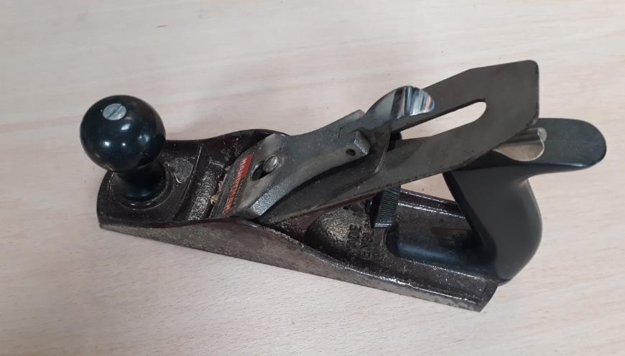
The Smoothing Plane
What most people picture when they things of a wood plane, the classic smoothing plane is the Stanley No 4. Similar body styles are available from other manufacturers, such as Record or Veritas. These planes are real workhorses, able to manage a number of different tasks around the shop, and can even be converted to scrub planes to allow you to rapidly hog off wood.
Choose again

Slide 4
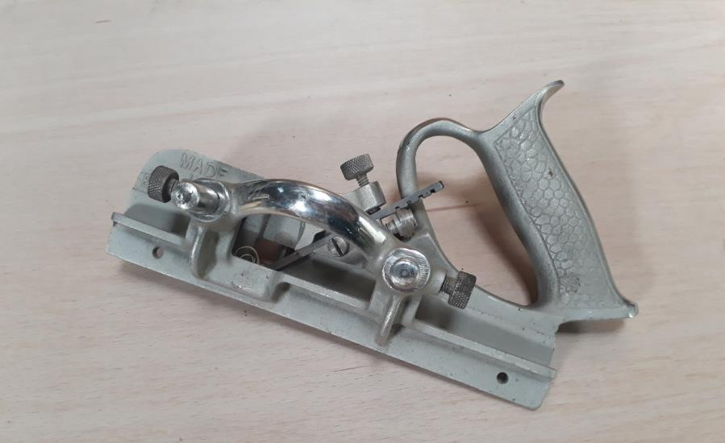
The Plough Plane
As the name suggests, these planes allow you to cut grooves into your wood. There are numerous options and styles available, but they typically come with fences and depth stops to help with accurate cutting. They can be used to cut housings for drawer bottoms, for rebated pieces or even decorative work. Furniture makers will use these a great deal!
Choose again

Slide 5
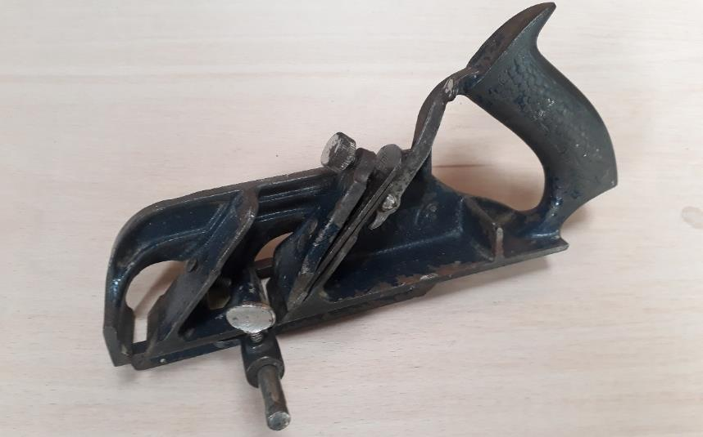
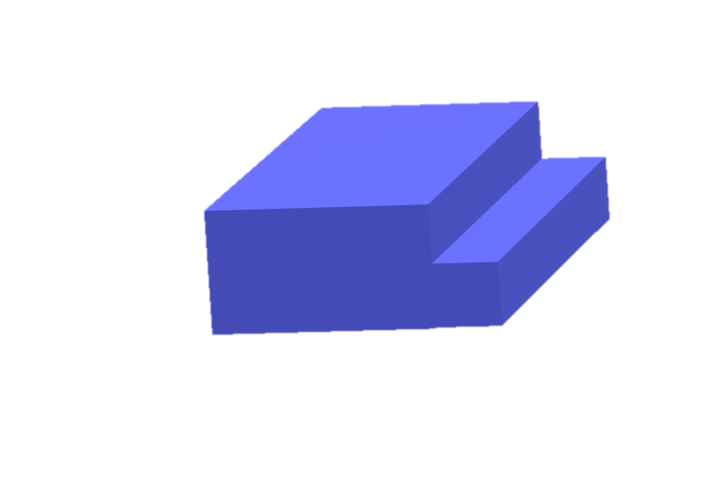
The Fillister Plane
Similar to a rebate/rabbet plane, but usually comes with a depth stop, fence and spur for cross-grain work. Cutting rebates is simple with one of these tools. Some simple decorative pieces can also be cut with these planes, such as stepped mouldings.
This is a rebate. It’s also often referred to as a rabbet – the difference is in which side of the Atlantic you’re on.
What is a rebate?
Choose again

