Slide 1
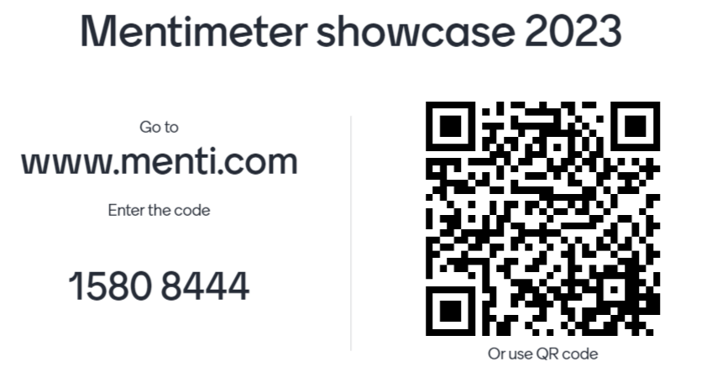
If you have lost connection from Mentimeter you can re-join here.

Slide 2
You have seen how Mentimeter can be used to create a dedicated learning activity…
… but how can it be implemented into your current practice?

Slide 3
Use Mentimeter parallel to PowerPoint
Pros: Student attention on screen or on own device as needed.
Cons: Need to flick between screens.
Mentimeter can be incorporated into existing PowerPoint-based materials.
Import PowerPoint slides into
Mentimeter
Pros: Seamless user experience with all slides in one place.
Cons: PowerPoint will be imported as static images,
meaning alt text will need to be added and existing animations, videos etc will not be present.
Use the Mentimeter plug-in for PowerPoint
Pros: Keeps the affordances of PowerPoint.
Cons: Some question types not available. Materials will need maintenance between years.

Slide 4
Bandwidth might present a problem
It’s anonymous
But network infrastructure is improving.
Impossible to see who
is participating and how.
Video can only be hosted on YouTube
Anonymity may allow for misbehaviour. There is a profanity filter, but may not be perfect.
(if you choose to present from
Mentimeter itself that is)
Mentimeter has some limitations…
This means videos on the video
portal or Vimeo can’t be used.
But you could choose to present from
PowerPoint instead.
Free text questions could be avoided of course.
Incorporating Mentimeter into existing materials will take time
Students need their own devices
Devices can be shared if necessary.
It can’t be squeezed into an existing session
without something being done to give students time to access and engage with the questions.

Slide 5
Mentimeter has a
wide variety of question
types and content slides. Unfortunately, we don’t have time to go through them all today.
Let’s take a look at a couple of different question types that may be suited to different circumstances.

Slide 6
Simple MCQ-style questions may be better for bigger groups, where it’s quicker for students to answer, easier for you to interpret the results, and simpler to explain.
This can mean multiple choice quiz questions…

Slide 7
… or polls.

Slide 8
For smaller groups, more complex question types may provide useful discussion points.
Open-ended or Q&A questions can be used for this.
Use Mentimeter or the Teams Q&A to ask any questions you may have.

