Slide 1


From Blackoard to Canvas
FROM BLACKBOARD
TO CANVAS
CLE open meeting
June
2025
SCHOOL OF MEDICAL SCIENCES CANVAS OPEN MEETING
JUNE 2025

Slide 2


Welcome and housekeeping
This session is being recorded.
Audience microphones will be switched off to reduce interruption. Cameras are welcome to stay on.
We have left the chat open and will do our best to answer any questions that have not been pre-submitted, time permitting.
The slides and recording, along with questions and answers will be circulated after the meeting.
The panel today will consist of:
FBMH eLearning team experts
Student Partners: Ashneet Kaur, Manas Kapur
Paul Shore (Associate Dean for Flexible and Digital Education)
Michael Smith (Technology-Enhanced Active Learning Lead)
Mark Johnson (Lecturer in Technology-Enhanced Learning)
Notes:
Welcome and housekeeping

Slide 3

Course Unit Canvas Standards
Course Unit Standards for Canvas are embedded in the design of the standard template that must be used for all units (unless previously agreed by the faculty Teaching and Learning Executive)
Implementation and Expectations: All Canvas course units must meet defined minimum standards, with additional desirable features encouraged. These are designed to enhance accessibility for all students.
Purpose and Development: The Course Unit Canvas Standards were co-developed by staff and students to guide teaching staff in creating consistent, high-quality online content.
Equity and Inclusion Focus: The standards aim to reduce educational inequalities by ensuring consistency, clarity, and inclusivity in course design.

Slide 4
Student Partner Activities
Attending FBMH CLE Implementation and CLE Communications meetings to:
  Voice the student perspective
  Highlight how students are experiencing the transition
Actively exploring Canvas to understand the student experience firsthand
Reviewing induction materials and providing:
  Feedback on clarity and usefulness
  Suggestions for improvement
  Reviewing and providing feedback on student-facing induction materials for relevance, tone, and clarity.
Supporting the communication strategy:
  Identifying the most effective ways to reach students
  Helping shape messaging that resonates with students
  Peer consultations to gain informal feedback on how others are getting on with the CLE transition.
  Collaborated on the creation of marketing and guide videos aimed at helping staff understand the student perspective and navigate Canvas effectively.

Slide 5
Student Partner Activities
Why Student Inclusion is Important in the CLE Transition
Staff are doing their best, but sometimes:
  The message doesn’t reach students effectively
  Communication doesn’t fully consider unique student situations (e.g. placement year, study abroad)
Students bring firsthand experience and can:
  Identify gaps in communication
  Ask peers if they’ve received and understood the messaging
  Share if students are finding the transition useful or confusing
Ensures the transition is more student-informed, inclusive, and impactful

Slide 6
Student Partner Activities
Immediate benefits in Canvas
Better Accessibility
  Canvas facilitates features such as the Immersive Reader and screen readers, ensuring learning becomes more inclusive to students with extra needs.
Mobile-Friendly Interface
  The Canvas mobile app is user-friendly and enables students to view content, submit assignments, and get notifications on their mobile devices.
Centralised Information Hub
  Canvas consolidates announcements, course content, timetables, and tests into a single location, simplifying confusion and improving navigation.
Consistent Course Layouts
  The template-based design promotes consistency between modules so that students can more easily locate information and adapt quickly to varying courses.
Improved Communication Tools
  Announcements, direct messaging, and calendar syncing features ensure students stay informed with fewer missed notifications.

Slide 7
Agenda (1 of 2)
Purpose of today’s meeting
  There is a little over 2 months until Canvas Go-Live
What’s coming up?
  Key milestones before launch
What do I need to do?
  Helping you prepare ahead of September
  Updates on work with UG Dentistry and UG Medicine
Important: Course Unit Standards
  Course Unit Standards
A tour of Canvas
  A demonstration of Canvas and the Canvas template
  Migration of Blackboard Courses – (MBChB bespoke arrangements)
  Migrated and legacy courses, scaffold archive
  Student communications
What will happen to my Blackboard courses?

Slide 8
Agenda (2 of 2)
When will Blackboard switch-off?
17 October 2025
Early move to Canvas
Assessment in Canvas
  Transition from Blackboard TII and Tests
  LTIs, opportunities to practice, mocks
Canvas training opportunities
  Training – f2f training, self-directed learning
  How to access
Programme and Community spaces
  How to request by form
  Migration of Blackboard programme and community spaces
Your questions
  Pre-submitted questions
  Questions raised in the chat (if time)
Next steps
Where to find information and support

Slide 9



FBMH Canvas Timeline
July
August
September
Build
70 days to go
Engage with Training and familiarise yourself with Canvas. Start to edit and build Canvas Units for 2025-26.
Develop
39 days to go
Staff to continue developing content, edit and build Canvas Units for 2025-26. Ready to launch for the publication date.
Publish
8 days to go
To meet DASS recommendations, Sem 1 and full year units to publish 2 weeks' worth of content by 8th September 2025.
Support
Canvas Central Drop-Ins (Stopford 1.060)
Bookable Training
Unit Construction
Canvas Basics
Assignments in Canvas
Quizzes in Canvas
Canvas Studio
October 2025
Blackboard switch-off – Colleagues and students will lose access to Blackboard on Friday 17 October.
Notes:
David
*Canvas Drop-Ins will run until September 2025, but eLearning support will be continuous.
**Training will continue post-September but less focused on Canvas mobilisation.

Slide 10
FBMH Canvas Timeline
July
Build
Staff should review and refine migrated content while developing any new materials in accordance with the Course Unit Canvas Standards (PDFs available). Staff can access Canvas Training and book using the available links. Personalised support is available through Canvas Central Drop-In sessions, located in Stopford Building 1.060.
August
Develop
This period is ideal for refining unit content, designing assignments and quizzes, structuring modules, planning student engagement through announcements, canvas studio and discussions, ensuring all materials meet accessibility standards.
September
Publish
To meet DASS recommendations, ensure all Sem 1 required content is published by 8th September 2025 and post a welcome announcement to introduce the unit. Following publication, staff can monitor student access and raise any technical issues through the Canvas help section. Sem 2 content should also look to publish 2 weeks before the course unit launches.
Notes:
David
*Canvas Drop-Ins will run until September 2025, but eLearning support will be continuous.
**Training will continue post-September but less focused on Canvas mobilisation.

Slide 11
What do I need to do?
Log in to Canvas https://canvas.manchester.ac.uk/
Sign up for training: https://elearning.bmh.manchester.ac.uk/training/canvas-training/
Put time aside between now and the end of August to build your S1 and Full-Year course
Follow the course template and course unit standards
Notes:
Laura 6

Slide 12
What do I need to do?
Make available at least 2 weeks’ course content
Publish your S1 or Full-Year course by the end of August
S1 and Full-Year courses are visible to students from 08 September 2025
Get support from the eLearning Team: https://elearning.bmh.manchester.ac.uk/about/
Canvas Central – drop-ins
Notes:
Laura 6

Slide 13
UG Dentistry:
Canvas Transition Project
Lisa Donlan, Chloe Beswick, Caitlin Stewart, Connor Allen
FBMH eLearning
Lisa.Donlan@manchester.ac.uk

Slide 14
Five-year undergraduate Bachelor of Dental Surgery (BDS) degree
Dentistry Blackboard Community Space
Three-year BSc Dental Hygiene and Therapy
Resources shared across two programmes

Slide 15
Universal Student Information
BDS Year 1
BDS Year 2
BDS Year 3
BDS Year 4
BDS Year 5
Bsc Year 1
BSc Year 2
BSc Year 3
All BDS & BSc Students: Generic Learning Materials; announcements etc.
All current BDS Year 1 students
All current BDS Year 2 students…
And so on…

Slide 16
How we can still allow students to look backwards…

Slide 17
“Live” Courses:
Universal Student Information
BDS Year 1
BDS Year 2
BDS Year 3
BDS Year 4
BDS Year 5
Bsc Year 1
BSc Year 2
BSc Year 3
All BDS & BSc Students
Current BDS Year 1 students
Current BDS Year 2 students
Current students enrolled
Regularly updated
Active spaces
“Reference” Courses:
BDS Year 1
BDS Year 2
BDS Year 3
BDS Year 4
BDS Year 5
Bsc Year 1
BSc Year 2
BSc Year 3
Current BDS Y2,3,4&5 students
Current BDS Y3,4&5 students
Allow students to "look backwards" until they have all of the Live Courses of their own (i.e. to allow Year 5 students to access Years 1 –4)
Inactive spaces for reference only

Slide 18
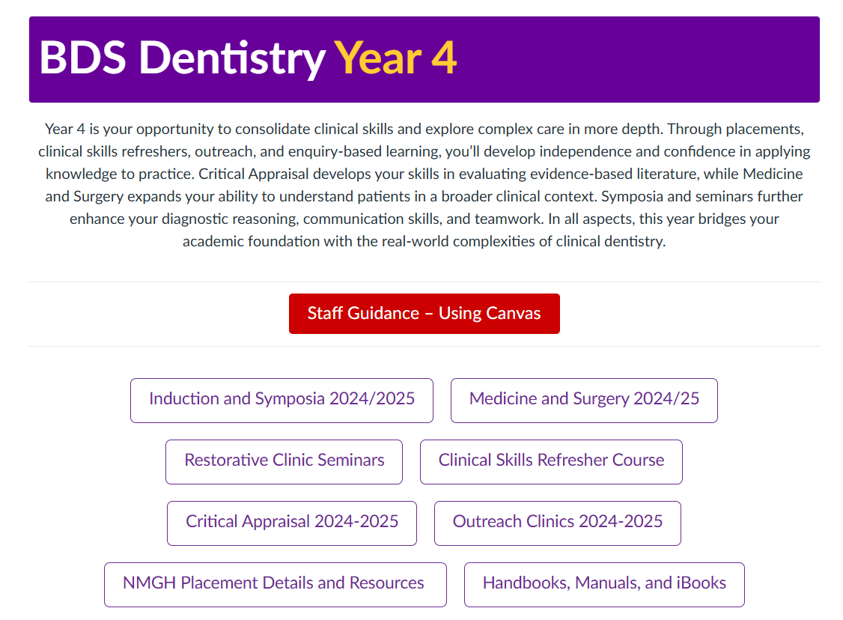

Slide 19
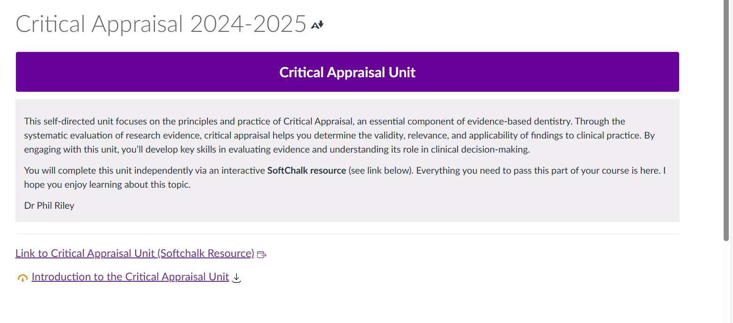

Slide 20
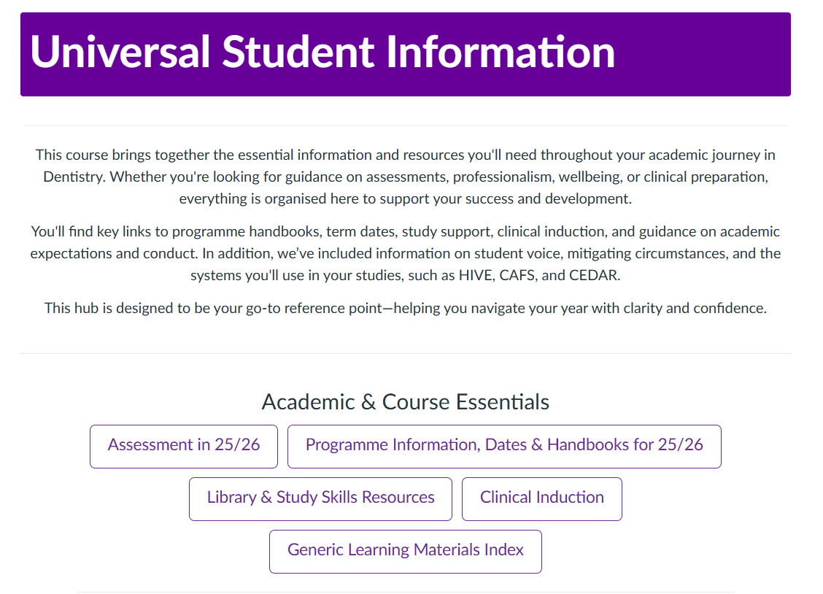

Slide 21
Dentistry-Specific Canvas Training Sessions (for PS and Academic staff)
Thursday 10/07/2025 14:00 - 16:00, Simon 3.40
Monday 14/07/2025 10:00 - 12:00, Simon 3.40
Wednesday 23/07/2025 10:00 - 12:00, Simon 3.40
Friday 25/07/2025 14:00 - 16:00, Simon 3.40
Support for Dentistry

Slide 22
1Med programmes
2025-26
MBChB Year 1 only
Manual migration [complete]
Bespoke training [ongoing]
Scaffolded revision [ongoing]
Support
2026-27
MBChB Years 2-5, GEM, PA
Migration options*
Bespoke training**
Scaffolded revision
Support
Notes:
Chris

Slide 23
Canvas Tour
Michael Smith
Notes:
Michael 10

Slide 24

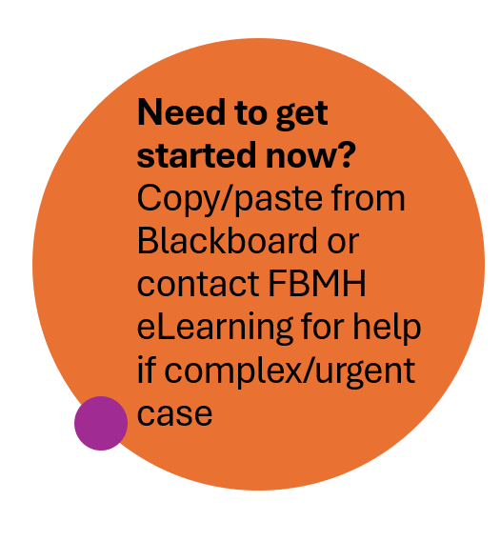
Migration of Blackboard Content
June 2025
Semester 1 migrated
(Completed June 2025)
23 June
🔄 Migration of Sem 2 / Whole Year / Community spaces underway
(Started w/c 23rd June)
Early-Mid July
Access to remaining migrated courses

Slide 25
Courses with late deadlines
What’s the issue?
Some courses have deadlines late in summer. The closing of Blackboard puts the submission, marking, exam board prep etc. at risk.
Which courses are affected?
Mainly PGT project/dissertation units, but some others (eg SBS UG placements). We have worked with the schools to identify the specific units affected
What’s the solution?
Affected courses will take submissions through a Canvas course space, while course content remains available on Blackboard for as long as possible.
Notes:
Ryan
What’s the issue?
Several units have deadlines that are late in summer. Student extensions push these deadlines even further, putting the whole assessment process from submission to ratification at risk of serious disruption because of the timing of Blackboard’s closure.
Which courses are affected?
Most of the units that are affected are PGT project or dissertation units, as these tend to have submission points from mid to late August. There are some other units as well, such as the SBS UG Placements unit. We’ve been working with schools to identify courses that are affected, and we feel fairly certain that we’ve captured them all. All the unit coordinators should have had an email from Ryan Metcalfe on the subject, though this was some time ago now. If anyone is concerned that their course may have been missed, do please contact eLearning.
What’s the solution for this?
To avoid disparity in student experience, it’s been decided that all affected units will take all submissions through Canvas, and that all marking will also be done through Canvas. Instead of a Turnitin link, students will follow a direct link to a Canvas Assignment. For as long as possible students will continue to access their course materials on Blackboard.

Slide 26
Courses with late deadlines
Where are we now?
Assessment submission courses have been created in Canvas.
Standard content has been produced, including student-facing guides to the assignment submission process in Canvas (very simple!).
Information on affected assessments is being collated.
What’s next?
Training and support for School A&P officers, with a follow-up workshop to get assignments created.
Communications with students – plan TBA
Post-October 17th decisions on course content access
Notes:
Ryan
Where are we now?
All the identified courses have a space in Canvas to take submissions. We’ve produced some draft content that can be posted in Blackboard to explain the situation to students. We’ve also produced instructions for submitting in Canvas, both a video and a written guide, which have been validated by our student partners. The process is very simple and intuitive, easier in many ways to the Turnitin submission process. Information on the affected assessments is being collated at the moment to try and make recreation of the assessments in Canvas as simple and speedy as possible.
What’s next?
In early July we’ll be training school A&P officers in how to manage assignments in Canvas, and we’ll be holding additional workshops to help support the process of setting all this up. Students will need to be informed of what’s happening to make sure they’re aware and have time to ask questions, but the roles and messages haven’t been defined yet. Schools also need to decide how to handle the needs of students with deadlines after the 17th October, when Blackboard access is cut off. The choices are to ask students to use the Legacy courses to access course content, or to copy content into the assessment submission courses. The general decision appears to be to use the Legacy courses, but some exceptions may exist.

Slide 27
Blackboard Assessment Migration
Assignments
Blackboard native assignments migrated, copied and used in Canvas
Turnitin assignments not migrated and will require rebuilding in Canvas
Blackboard Question Banks and Pools become Canvas Item Banks and are migrated
Rubrics
Turnitin rubrics not supported in Canvas, to be rebuilt using Canvas Enhanced Rubrics
Blackboard native rubrics migrated and can be reused (to be checked)
Quizzes
All but 1 question format from Blackboard is supported in Canvas.
Question settings and deployment options similar with only minor amendments (not settings)
Assessment Settings
Will need to be reset and reconfigured for Canvas deployment. (Dates, grading, deployment, adaptive release, TII Framework, anonymous grading)
Notes:
Adrian
Marking settings?
Partial credit different in Bb
Pattern matching

Slide 28
Assessment
Turnitin
Moving from Feedback Studio (marking) to TII Plagiarism Framework (similarity reports only). Canvas SpeedGrader will be used for marking and grading.
Quizzes / Exams
The default exam format will be using Canvas quizzes. 12 question formats, deployment settings, marking and reporting options, adaptive release, marking in SpeedGrader, rubrics, Item Banks
Rubrics
Marking and grading using rubrics in Canvas for assignments.
PS Assessment Overview & Support
Multiple sessions presenting an overview of the assessment process and associated mechanisms using Canvas features and functions. Dedicated Teams channel to continue the help, support and communication process.
LTIs
Cadmus, PebblePad (account request required) , Softchalk, PeerScholar, Gradescope, Buddycheck – all available as LTIs in Canvas.
Notes:
Adrian

Slide 29
Training
Primarily face to face in Canvas Central: 1.061 – 1.063 Stopford Building
Asynchronous courses available for Content building
Coming soon: Asynchronous courses for assessment and quizzes
Book here: https://elearning.bmh.manchester.ac.uk/training/canvas-training/
Notes:
Kate

Slide 30
Courses available for content building
Unit Construction workshop
  Unit coordinators
  Minimum standards
  How to consider course structure
  How to construct content
  How to move existing content into real new courses
Canvas Basics
  Any faculty staff
  Minimum standards
  How to construct content
  How to move existing content into real new courses
  Student comms
  Calendars
Book here: https://elearning.bmh.manchester.ac.uk/training/canvas-training/
Notes:
Kate

Slide 31
Courses available for Assessment building
Creating and managing Assignments in Canvas
  Anyone who created/ran Blackboard or Turnitin Assignments
  Create assignments based on requirements
  Inform students of deadlines
  Weight grades
  Grades and marking
Quizzing and testing in Canvas
  Anyone who created/ran Blackboard tests, and/or wishes to run Canvas Quizzes
  Make quizzes
  Copy existing quizzes into your course
  Test that quizzes function as expected
  Release Quizzes to students
  Mark quizzes
Book here: https://elearning.bmh.manchester.ac.uk/training/canvas-training/
Notes:
Kate

Slide 32
Courses available for releasing your content
Unit deployment workshops
  Unit coordinators
  Check your template is filled in
  Checking and publishing your content, quizzes, assignments etc
  Adaptive release
  Publishing your course so its available to students
  Student communication
  Calendar
Book here: https://elearning.bmh.manchester.ac.uk/training/canvas-training/
Notes:
Kate

Slide 33
Courses available for Interactive video
Interactive Video with Canvas
  Anyone interested in hosting their own video collections.
  How to host video
  Creating interactivity in video
  Subtitles
  Video assignments for student submission
Book here: https://elearning.bmh.manchester.ac.uk/training/canvas-training/
Notes:
Kate

Slide 34
Training support: transition drop-ins
Daily drop-ins where you can talk to a canvas expert about your course
Work alongside eLearning Team to make your course a success
Ask questions
Design your course with help
Designing your assessments and making sure they work
Canvas Central: https://elearning.bmh.manchester.ac.uk/canvas/central/
Notes:
Kate

Slide 35
Also coming soon…
Digital Discovery Series will return
  How to mark student work
  How to add students into hidden administrative groups
  How to add Cadmus
  + many more!
Notes:
Kate

Slide 36
Training stats so far…
Total attendees at training events so far:
Unit Construction Workshops (Unit Coordinators): 221
Canvas Basics (Teaching staff): 79
PS Orientation to Canvas (PS): 51
Notes:
Kate

Slide 37
Programme & Community Spaces
Will my Programme and Community Spaces be copied over?
Existing Blackboard Programme and Community space content such as files and video links will be copied to a holding space in Canvas.
How do I request a Canvas Programme and Community Space?
You can use this form to request a space, and this one to request a banner.
How do I construct my new Space?
Construction is the same as for courses – copy content over or create new content.
Notes:
Laura

Slide 38



Your questions
Notes:
Answers spread

Slide 39



FBMH Canvas Support
Canvas Microsite
Canvas Central
Canvas Training
Contact FBMH eLearning
elearning.bmh.manchester.ac.uk/canvas
FBMH eLearning Community (Viva Engage)
Notes:
David

Slide 40
Next steps & Key takeaways
We will circulate the slides, recording and FAQs
Put time aside between now and the end of August to build your S1 and Full-Year course
Sign up for training: https://elearning.bmh.manchester.ac.uk/training/canvas-training/
Rebuild your courses using the Template, Course Unit Standards and migrated data provided.
Publish your S1 or Full-Year course by the end of August
Share important information with colleagues.
Remind students to download their submissions and feedback.
Get in touch if your needs are complex or unusual
Get support from the eLearning Team: https://elearning.bmh.manchester.ac.uk/about/
Canvas Central – drop-ins
October 2025
Blackboard switch-off – Colleagues and students will lose access to Blackboard on Friday 17 October.
Notes:
Next steps
Reminders of key actions and where to access support.

